Slide 1
Atomic structure
1.1 Particles in the atom and atomic radius
1.2 Isotopes
1.3 Electrons, energy levels and atomic orbitals
1.4 Ionisation energy

Slide 2
Introduction
Scientists have discovered 118 elements up till now. Each element has different properties. In this article, the structure of an atom, particles within an atom and their behaviour are discussed.
This article also introduces the concept of how electrons are arranged in an atom. The atomic orbitals and their shapes are also discussed. The number of atomic orbitals a principal quantum shell carries is also explained in brief. The order in which electrons are filled in each atomic orbital is an important concept that links with the arrangement of elements on the periodic table.
Based on electronic configuration of elements, we will learn about the trend in atomic radii and ionisation energies. Using the values of successive ionisation energies, we can also deduce the position of an element.

Slide 3
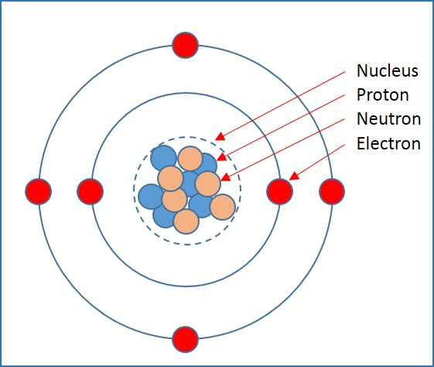
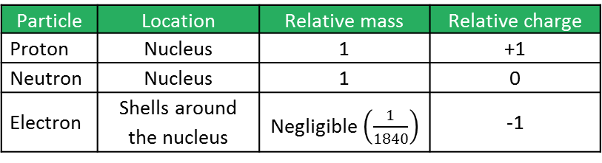
Structure of an atom
An atom consists of a nucleus and electrons orbiting around the nucleus.
A nucleus consists of protons and neutrons.
Protons are particles with a positive electrical charge and neutrons carry a neutral electrical charge.
Both protons and neutrons have the same mass.
An electron carries a negative electrical charge and has almost no mass.
Particle | Location | Relative mass | Relative charge
Proton | Nucleus | 1 | +1
Neutron | Nucleus | 1 | 0
Electron | Shells around the nucleus | Negligible $\left(\frac{1}{1840}\right)$ | -1

Slide 4
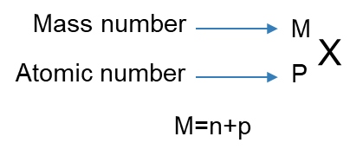
Mass number and atomic number
In a neutral atom, the number of protons and the number of electrons are always equal because their charge is equal in size but opposite in nature.
Each element is represented in the form of ^{M}_{P}X, where X is the symbol of the element, M is the mass number or nucleon number, and P is the proton or atomic number.
Mass number is the total number of protons and neutrons in an atom.
Atomic number is the number of protons in an atom.

Slide 5



Mass number and atomic number
Examples
Element | Symbol | Mass number (p+n) | Atomic number (p) | Number of protons (p) | Number of neutrons (n)
Sodium |  | 23 | 11 | 11 | 12
Aluminium |  | 27 | 13 | 13 | 14
Calcium |  | 40 | 20 | 20 | 20
$${}_{11}^{23}{Na}$$
$${}_{13}^{27}{Al}$$
$${}_{20}^{40}{Ca}$$

Slide 6
Isotopes & Calculating Relative Atomic Mass
Isotopes are different forms of the same element, having different masses.
Isotopes have the same number of protons but a different number of neutrons.
Relative isotopic mass is the mass of one isotope compared to one-twelfth of the mass of one carbon-12 atom.
Relative atomic mass is the average mass of one atom of an element compared to one-twelfth of the mass of one carbon-12 atom.
Relative masses are ratios of two masses and, hence, do not have any units.
$$relative atomic mass \left(A_{r}\right)=\frac{Average mass of one atom of an element}{ one−twelfth of the mass of one carbon−12 atom }$$
$$relative isotopic mass=\frac{mass of one isotope}{ one−twelfth of the mass of one carbon−12 atom }$$

Slide 7
Isotopes & Calculating Relative Atomic Mass
Boron is available in two forms: ${}_{5}^{10}B$ and ${}_{5}^{11}B$. The relative composition of isotopes of boron found by mass spectroscopy is given in the table below:
 | Boron-10 | Boron-11
Relative isotopic mass | 10 | 11
Relative abundance | 23 | 100
$$Relative atomic mass=\frac{sum\left(isotopic mass×relative abundance\right)}{total relative abundance}$$
$$Relative atomic mass=\frac{(10×23)+(11×100)}{123}$$
$$Relative atomic mass of boron=10.81$$

Slide 8
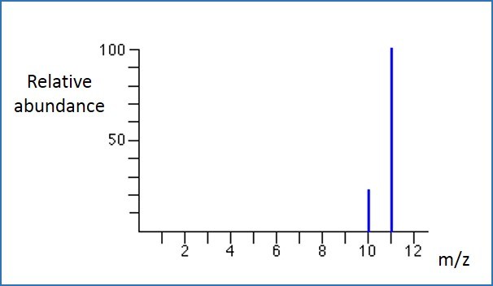
Mass spectrum - Boron
The mass spectroscopy result for boron is given in the figure.
It can be noted that there are two isotopes of boron: 10 and 11. The relative abundance for B-10 is 23 and for B-11 is 100 in the sample.
Using this data, the relative atomic mass of boron can be calculated.

Slide 9
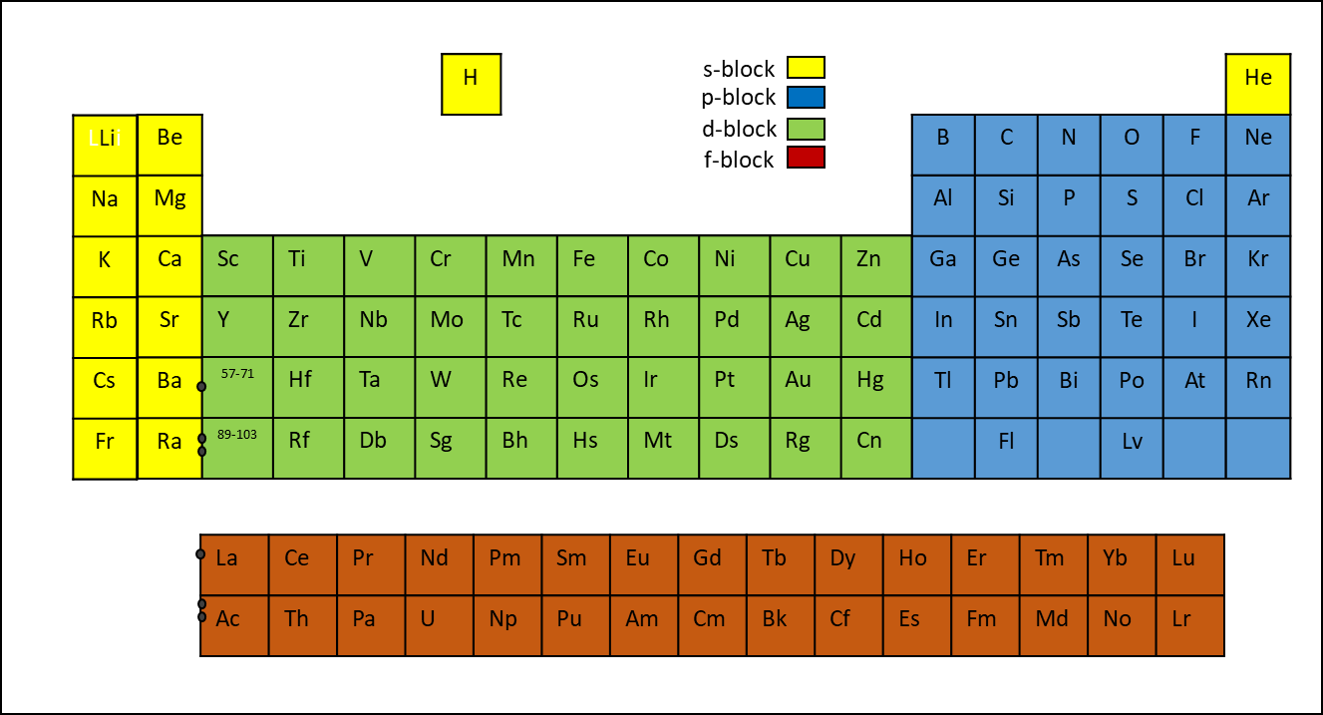
Structure of the periodic table
The periodic table is arranged in order of atomic number.
There are 18 groups.
All elements of a group have similar chemical properties.
The rows of the periodic table are called a period.
The recurrence of the same pattern is called periodicity.
The modern periodic table

Slide 10
The periodic table
The periodic table can be divided into three blocks: s-block, p-block and d-block.
s-block: Hydrogen, Helium, Group 1 and group 2 elements have the outermost electrons in an s-shell
p-block: Group 13 to 18 (except He) have the outermost electrons in a p-shell
d-block: Elements that have the outermost electrons in a d-shell. These elements are also called transition elements.
f-block: Elements that have the outermost electrons in an f-shell.

Slide 11
Electronic Configuration
The electrons around the nucleus are arranged in principal quantum shells (symbol n).
The number maximum number of electrons a sub-shell can hold is based on the formula, 2n² where n is the number of main level.
The arrangement of electrons in an atom is called its electronic configuration.
Each principal quantum shell can hold a maximum number of electrons as per the table given.
The quantum shell n=1 is the closest to the nucleus, n=2 is the next shell and so on.
Quantum shell | Maximum number of electrons (2n²)
n=1 | 2
n=2 | 8
n=3 | 18
n=4 | 32

Slide 12
Electronic Configuration
Examples:
He
C
Element | Number of electrons | Number of electrons
 |  | n=1 | n=2 | n=3
Helium | 2 | 2
Carbon | 6 | 2 | 4
Magnesium | 12 | 2 | 8 | 2
Mg

Slide 13
Quantum Sub-shells
The principal quantum shells (except for n=1) are split into sub-shells.
The sub-shells are sub-divided as s, p, d and f.
n=1 principal quantum shell consists of one s sub-shell and carries maximum of 2 electrons.
n=2 principal quantum shell consists of one s sub-shell and one p sub-shell. Thus, carries a maximum of 8 electrons.
n=3 principal quantum shell consists of one s sub-shell, one p sub-shell and one d sub-shell. Thus, carries a maximum of 18 electrons.
principal quantum shell (n=) | quantum sub-shells | maximum number of electrons
1 | s | 2
2 | s and p | 2+6=5
3 | s, p and d | 2+6+10=18

Slide 14
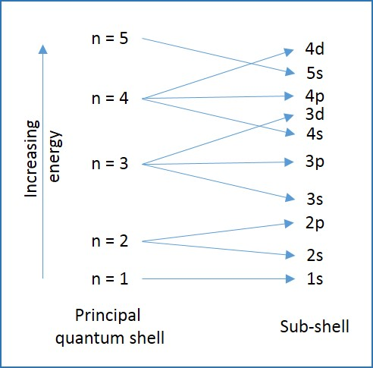
Quantum Sub-shells
The electrons fill up the sub-shells in increasing order of energy in each sub-shell.
Until the atomic number of 18 (Argon), the shells are filled in order: 1s, 2s, 2p, 3s and 3p.
For potassium (atomic number 19), the electron fill up the 4s sub-shell rather than 3d sub-shell.
This is because the energy of 4s is less than that of 3d.

Slide 15
Atomic Orbitals
An atomic orbital is the region of space around the nucleus that can be occupied by one or two electrons.
Each quantum sub-shells is made of one or more atomic orbitals.
The number of atomic orbitals for each sub shell is given in the table.
Sub-shell | Number of atomic orbitals | Maximum number of electrons
s | 1 | 2
p | 3 | 6
d | 5 | 10
f | 7 | 14

Slide 16
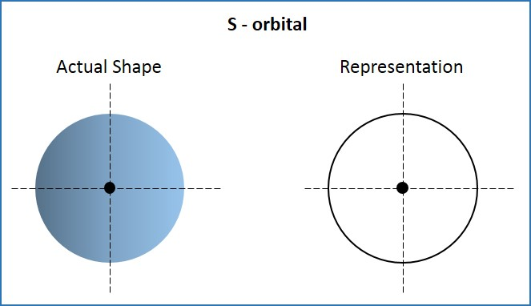
Atomic Orbitals: s-orbital
Each orbital is a three-dimensional structure.
A s-orbital has a spherical shape.
All s-orbitals have the same shape but the energy of 2s orbital is greater than that in 1s orbital and so on.

Slide 17
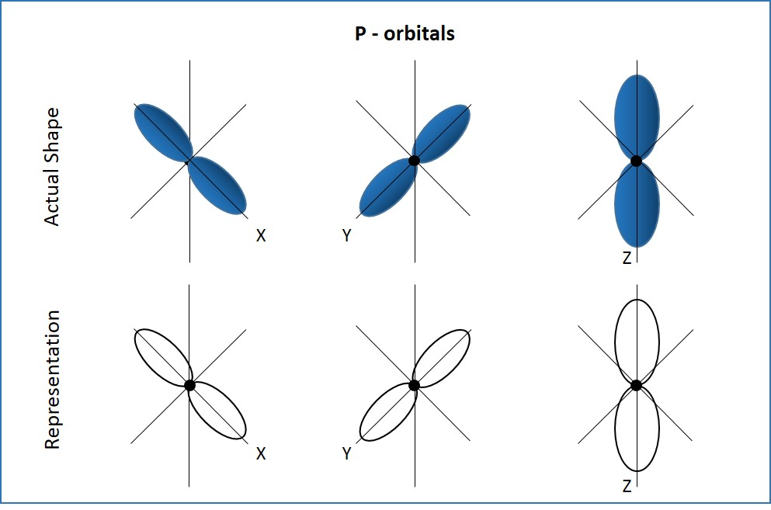
Atomic Orbitals: p-orbital
A p-orbital has a lobe like structure as shown in figure.
There are three 2p orbitals and each of them have the same structure but each of them is aligned in x, y and z axis. Hence, the naming of these orbitals are 2px, 2py and 2pz.
The shape of 3p orbitals is similar to that of 2p orbitals.

Slide 18
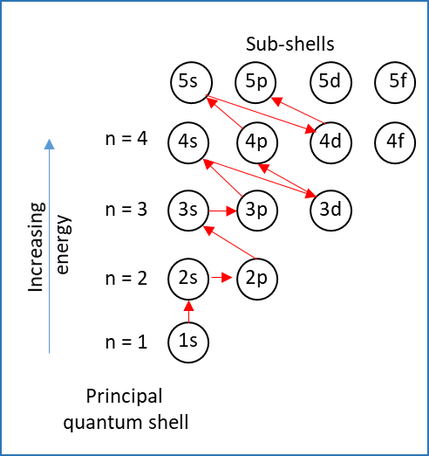
Filling of Orbitals
The shells are filled in the increasing order of energy levels.
The order in which the electrons are filled is shown in the figure.

Slide 19
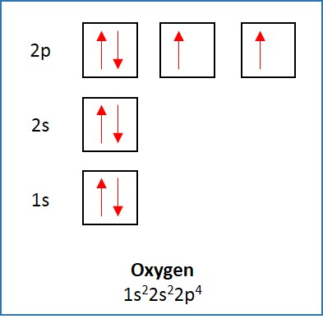
Filling of Orbitals
Filling up of orbitals is expressed by placing arrows in boxes. Arrows denote the electrons.
The direction in which the arrow points, denotes the spin of electron.
An electron rotates in its own axis in either clockwise or anti-clockwise direction.
In an orbital, electrons rotate in opposite directions, and hence, have opposite spins.

Slide 20
Filling of Orbitals
Electrons are negatively charged. As like charges repel each other, electrons occupy separate orbitals if possible.
Only when the all orbitals of a sub shell are filled with one electron, the electrons are paired in those orbitals.
The paired electrons always have opposite spins to minimise repulsions.

Slide 21
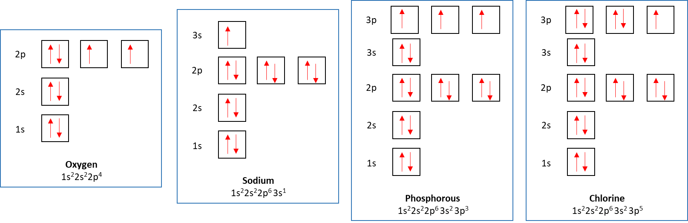
Filling of Orbitals: Examples

Slide 22
Electron configurations
The electron configuration of an element denotes the number of electrons in each sub shell in order. For example, helium has 2 electrons which are filled in the 1s orbital. The electron configuration is written as:
electron configuration of He=1s²
where 1 represents the principal quantum number, s represents the sub-shell and 2 represents the number of electrons in 1s sub-shell.
Similarly, electron configuration of nitrogen (atomic number=7) is written as:
electron configuration of N=1s²2s²2p³

Slide 23
Electron configurations
The electron configurations up to atomic number of 36 is required. There are few points to be noted:
The electrons fill the 4s sub-shell before filling up the 3d sub-shell.
For example:
Potassium has atomic number of 19
electron configuration of K=1s²2s²2p⁶3s²3p⁶4s¹
Calcium has atomic number of 20
electron configuration of Ca=1s²2s²2p⁶3s²3p⁶4s²

Slide 24
Electron configurations
The electrons fill up 3d sub shell after filling up 4s sub shell. For example:
Scandium has atomic number of 21
electron configuration of Sc=1s²2s²2p⁶3s²3p⁶4s²3d¹
Some exceptions to this pattern are Chromium (atomic number=24) and copper (atomic number=29). It can be noted that 4s shell is filled with only one electron for these two elements.
electron configuration of Cr=1s²2s²2p⁶3s²3p⁶3d⁵4s¹
electron configuration of Cu=1s²2s²2p⁶3s²3p⁶3d¹⁰4s¹

Slide 25
Electron Configuration of ions
Positive ions are formed when atoms lose electrons.
For s-block elements, electrons are lost from the outermost s-shell.
For example: electron configuration of Calcium is 1s²2s²2p⁶3s²3p⁶4s².
Calcium loses two electrons and forms Ca²⁺.
Electron configuration of Ca²⁺=1s²2s²2p⁶3s²3p⁶
The configuration of Ca²⁺ is similar to that of Argon (Atomic number =18) which is a noble gas.

Slide 26
Electron Configuration of ions
Negative ions are formed when atoms gain electrons.
For example: electron configuration of oxygen is 1s²2s²2p⁴.
Oxygen gains two electrons and forms O²⁻.
Electron configuration of O²⁻=1s²2s²2p⁶
The configuration of O²⁻ is similar to that of Neon (Atomic number =10) which is a noble gas.

Slide 27
Periodic trends in electronic configurations
The pattern in the electronic configuration of period 2 and period 3 elements:
Element (Period 2) | Electronic configuration | Element (Period 3) | Electronic configuration
Li | [He]2s¹ | Na | [Ne]3s¹
Be | [He]2s² | Mg | [Ne]3s²
B | [He]2s²2p¹ | Al | [Ne]3s²3p¹
C | [He]2s²2p² | Si | [Ne]3s²3p²
N | [He]2s²2p³ | P | [Ne]3s²3p³
O | [He]2s²2p⁴ | S | [Ne]3s²3p⁴
F | [He]2s²2p⁵ | Cl | [Ne]3s²3p⁵
Ne | [He]2s²2p⁶ | Ar | [Ne]3s²3p⁶

Slide 28
Electronic configuration of transition elements
Transition element is a d-block element that forms one or more stable ions with an incomplete d sub-shell.
The electronic configuration of d block elements of period 4 is given in the table below.
Element | Atomic number | Electronic configuration | Ions
Scandium (Sc) | 21 | [Ar]3d¹4s² | Sc³⁺
Titanium (Ti) | 22 | [Ar]3d²4s² | Ti³⁺, Ti⁴⁺
Vanadium (V) | 23 | [Ar]3d³4s² | V²⁺, V³⁺, V⁴⁺, V⁵⁺
Chromium (Cr) | 24 | [Ar]3d⁵4s¹ | Cr³⁺, Cr⁶⁺

Slide 29
Electronic configuration of transition elements
Element | Atomic number | Electronic configuration | Ions
Manganese (Mn) | 25 | [Ar]3d⁵4s² | Mn²⁺, Mn³⁺, Mn⁴⁺, Mn⁶⁺, Mn⁷⁺
Iron (Fe) | 26 | [Ar]3d⁶4s² | Fe²⁺, Fe³⁺
Cobalt (Co) | 27 | [Ar]3d⁷4s² | Co²⁺, Co³⁺
Nickel (Ni) | 28 | [Ar]3d⁸4s² | Ni²⁺
Copper (Cu) | 29 | [Ar]3d¹⁰4s¹ | Cu¹⁺, Cu²⁺
Zinc (Zn) | 30 | [Ar]3d¹⁰4s² | Zn²⁺

Slide 30
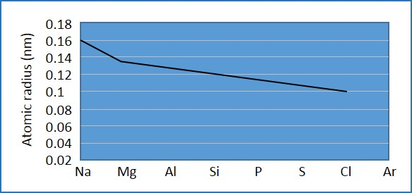
Periodic trend in atomic radius
Across a period, the number of protons and electrons increases by one with each successive element.
With increase in number of protons, the force of attraction between the nucleus and the electrons increases.
As the force of attraction increases, the atomic radius decreases.
Hence, across a period from left to right, the atomic radius decreases.
Periodic trend in atomic radius

Slide 31
Measuring atomic radius
The covalent radius is measured by finding the distance between two nuclei of same atom. Half of the covalent radius gives us the atomic radius.
Metallic radii and van der waals’ radii are other measures of atomic radii.
Argon does not form covalent bonds because it has stable configuration and hence, covalent radii of Argon is not available.

Slide 32
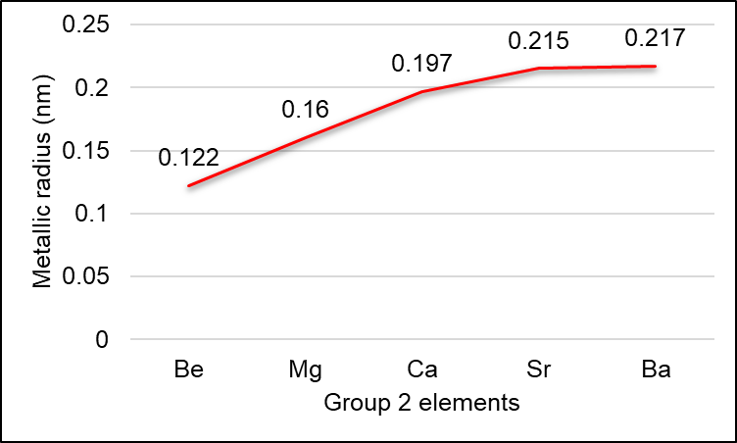
Trend in atomic radius
The atomic radius of elements increases down the group.
This is because a new principal quantum shell away from the nucleus is filled as we go down the group.
The trend in metallic radius of group 2 elements is given.

Slide 33
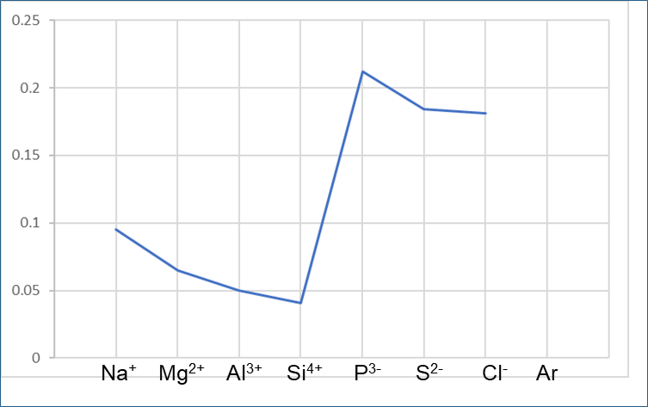
Periodic trend in ionic radius
Metallic elements form positive ions and non-metallic elements form negative ions.
Positive ions lose electrons to become stable and therefore, lose the outermost shell and become smaller than the original atom.
The shielding effect of outer electrons also reduces in positive ions.
Across the period, the ionic radius reduces for positive ions due to increase in nuclear charge (increased force of attraction).
The trend of this ionic radius is shown in figure.
Ionic radius (nm)
Periodic trend in atomic radius

Slide 34
Periodic trend in ionic radius
Alternatively, negative ions accept electrons to become stable.
The repulsion between electrons increases the size of negative ions when compared to original atoms.
Across the period, the size of negative ions reduces due to increase in nuclear charge.
Ionic radius (nm)
Periodic trend in atomic radius

Slide 35
Periodic trends in ionisation energy
First ionisation energy of an element is the energy required to remove one electron from each atom in one mole of atoms of an element in its gaseous state to form gaseous 1+ ions. It is measured in kJ/mol.
X(g)→X⁺(g)+e⁻
The ionisation energy generally increases across a period and decreases down the group.

Slide 36
Factors that affect the ionisation energy
Size of nuclear charge: Across the period towards right, the number of protons and electrons increases and the force of attraction between nucleus and electrons increases. Hence, more energy is required to remove electron from the outermost shell. Ionisation energy increases with increase in atomic number.
Distance of valence electrons from the nucleus: As the distance of valence electrons increases from the nucleus, the force of attraction gets weaker and hence, ionisation energy decreases.
Shielding of inner electrons: As the number of filled electron shells between the valence electrons and the nucleus increases, the ionisation energy decreases. The inner electrons reduce the force of attraction as they repel the valence electrons.

Slide 37
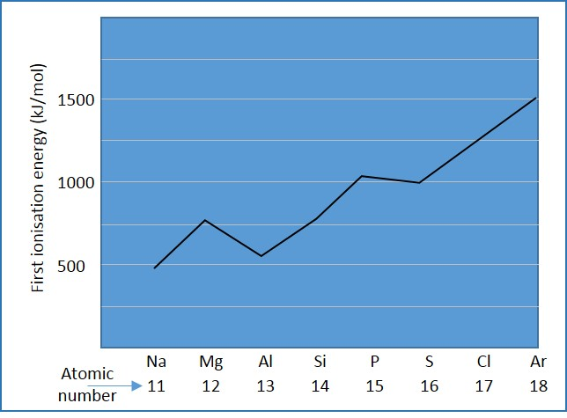
Periodic trends in ionisation energy
The ionisation energies decrease down the group because the valence electrons are shielded by the filled orbitals.
The distance between the valence electrons and nucleus also increases down the group, making it easy to remove valence electron.
The ionisation energy of elements of period 3.
Period 3 element | First ionisation energy (kJ/mol)
sodium (Na) | 494
magnesium (Mg) | 736
aluminium (Al) | 577
silicon (Si) | 786
phosphorus (P) | 1060
sulfur (S) | 1000
chlorine (Cl) | 1260
argon (Ar) | 1520
Periodic trends in ionisation energy

Slide 38
Periodic trends in ionisation energy
Generally, the first ionisation energy across the period increases towards right due to increase in atomic number.
There are small dips across the period between Magnesium and Aluminium, and between Phosphorous and Sulphur.
These dips are also found in period 2 between Beryllium and Boron, and Nitrogen and Oxygen.

Slide 39
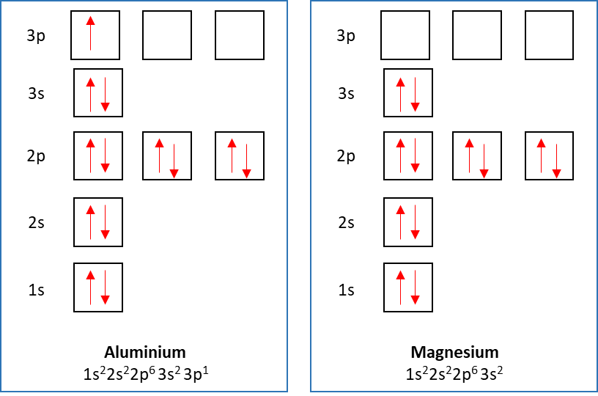
Periodic trends in ionisation energy: dips between Mg and Al
Aluminium has one electron in its 3p orbital.
It requires less energy to remove one electron from p-shell when compared to that of Magnesium. This is due to shielding of valence electrons in 3p orbital by electrons in 3s orbital.
In case of Mg, the shielding is comparatively less.
I.E₁ of Al < I.E₁ of Mg

Slide 40
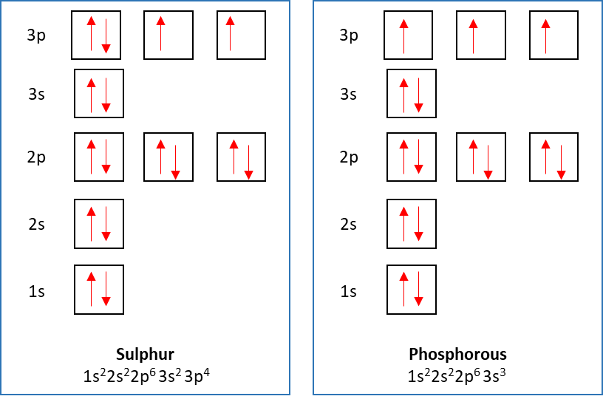
Periodic trends in ionisation energy: dips between P and S
In phosphorous, each 3p orbital consists of an electron.
Sulphur has 2 pair of electrons in one of the 3p orbitals.
There is a force of repulsion between these paired electrons which makes it easier to remove even though atomic number increases.
I.E₁ of S < I.E₁ of P

Slide 41
Predicting electronic structure using successive ionisation energy
Successive ionisation energy is the energy required to remove one mol of electrons from one mol of positive gaseous ions.
The successive energies are always greater than the first ionisation energy.
A positive ion is smaller than the atom and, hence, the force of attraction between the nucleus and the valence electron increases.
Successive ionisation energies are used to predict the number of electrons in each shell of an atom and the group of an element

Slide 42
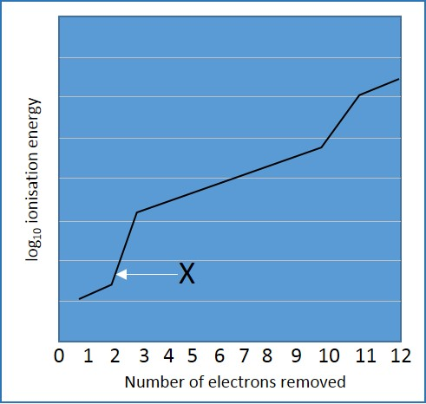
Predicting electronic structure using successive ionisation energy: Example
Consider the graph that shows the log₁₀ ionisation energy versus the number of electrons removed from magnesium.
Why are the first two electrons easier to remove?
Why is it difficult to remove the 3rd electron when compared to the first 2 electrons?
What does this graph tell us about the electron configuration of magnesium?

Slide 43
Predicting electronic structure using successive ionisation energy: Example
Solution:
Why are the first two electrons easier to remove?
The outermost shell is the s-subshell.
The outermost electrons have greatest shielding from nucleus by the inner electrons.
The force of attraction between the outermost electrons and the nucleus is the least.

Slide 44
Predicting electronic structure using successive ionisation energy: Example
Why is it difficult to remove the 3rd electron when compared to the first 2 electrons?
Once the second electron is removed, the size of the atom is significantly reduced, which leads to an increase in the force of attraction between outermost electrons and nucleus.
Also, there is less shielding by inner electrons.

Slide 45
Predicting electronic structure using successive ionisation energy: Example
Solution:
What does this graph tell us about the electron configuration of magnesium?
The outermost shell contains 2 electrons. The next shell contains 8 electrons. The innermost shell contains 2 electrons.

